Slide 1

Presentation : Lab Assignments Based on
Name : Atrij Roy
Section : A2
Roll no : 002311001086

Slide 2
At a glance : Contents
S.No. | Assignment | Core AI Concept | Key Algorithms
1 | Game State Search | Heuristic Search | Best-First Search (Greedy)
2 | Association Rule/Data Analysis | Data Mining & Graph Theory | Transaction Encoding & NetworkX Graph
3 | Towers of Hanoi | Classical Search | Recursion, Breadth-First Search (BFS)
4 | Farmer, Wolf, Goat, Cabbage | Uninformed Search | DFS, BFS, IDS, UCS, ILS
5 | Traveling Salesperson Problem (TSP) | Heuristic Optimization | Hill Climbing, Simulated Annealing
6 | 8-Puzzle (N-Puzzle) | Iterative Deepening Search | DLS, Iterative Deepening Search (IDS)

Slide 3
Tic Tac Toe: Problem Formulation & State Space
Goal: Find a sequence of moves to transform a Start State into a Goal State on a grid, following specific placement rules.
Core Concept: Heuristic Search / Pathfinding.
State Space: A matrix/list of lists where each cell is ‘x’, ‘o’, or ‘-’. Moves are constrained: a player can only place their piece in an empty cell that matches the desired piece in the Goal State.
Example Start/Goal:
Start: [[‘x’, ‘-’, ‘-’, ‘-’], [‘-’, ‘-’, ‘-’, ‘-’], [‘-’, ‘-’, ‘-’, ‘-’], [‘-’, ‘-’, ‘-’, ‘-’]]
Goal: [[‘x’, ‘o’, ‘o’, ‘x’], [‘x’, ‘-’, ‘-’, ‘-’], [‘-’, ‘-’, ‘-’, ‘-’], [‘-’, ‘-’, ‘-’, ‘-’]]
Element | Representation
Cross (X) | x
Circle (O) | o
Empty | -- or ''

Slide 4
Best-First Search (Greedy) Algorithm
The problem is solved using Greedy Best-First Search (GBFS), where the search is guided entirely by the Heuristic Function .
GBFS Steps:
Initialize a Priority Queue (PQ) with the start state, using its value as the priority.
Maintain a Visited Set to prevent loops.
While the PQ is not empty:
Pop the state with the lowest .
If the state is the Goal State, return the path.
Generate all next possible moves (neighbors) by placing the next piece ('x' or 'o') in a valid empty cell that matches the goal.
For each new neighbor, calculate and push the neighbor onto the PQ if it hasn't been visited.
Key Step: Heuristic Function h(curr,goal) ---- h(n) estimates the cost to reach the goal, prioritizing states closer to the target configuration
Condition | Penalty to
Current state matches Goal state | 0
Placed a piece in a cell that should be empty (g == '-' and c != '-') | 100 (Large)
Cell should be filled but is empty (g != '-' and c == '-') | 1 (Small)
Mismatch (Wrong piece placed) (g != '-' and c != g) | 100 (Large)

Slide 5
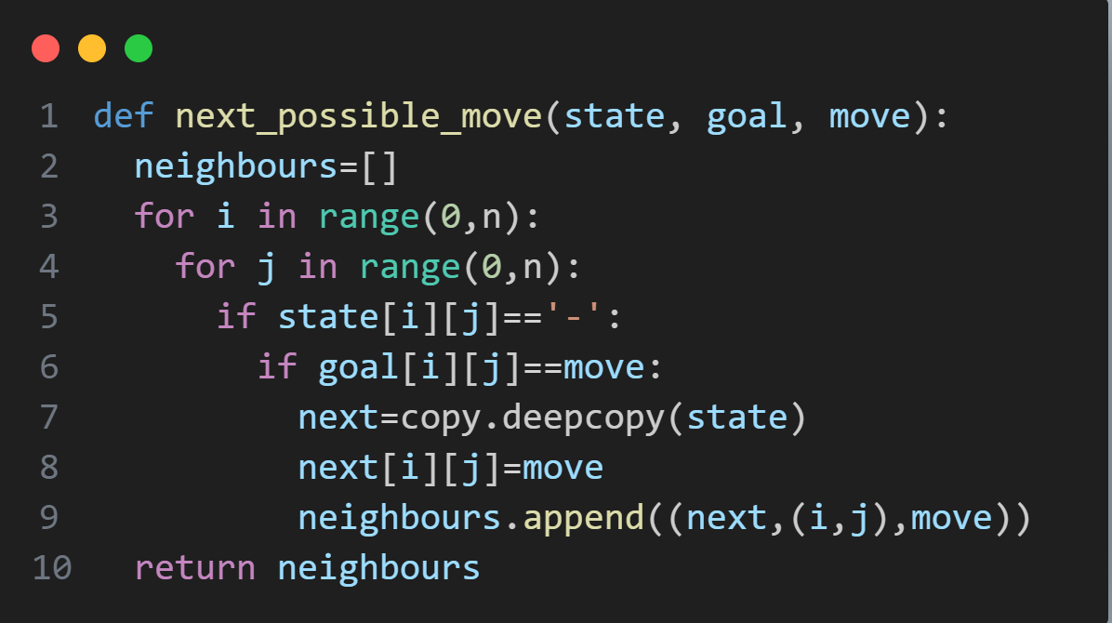
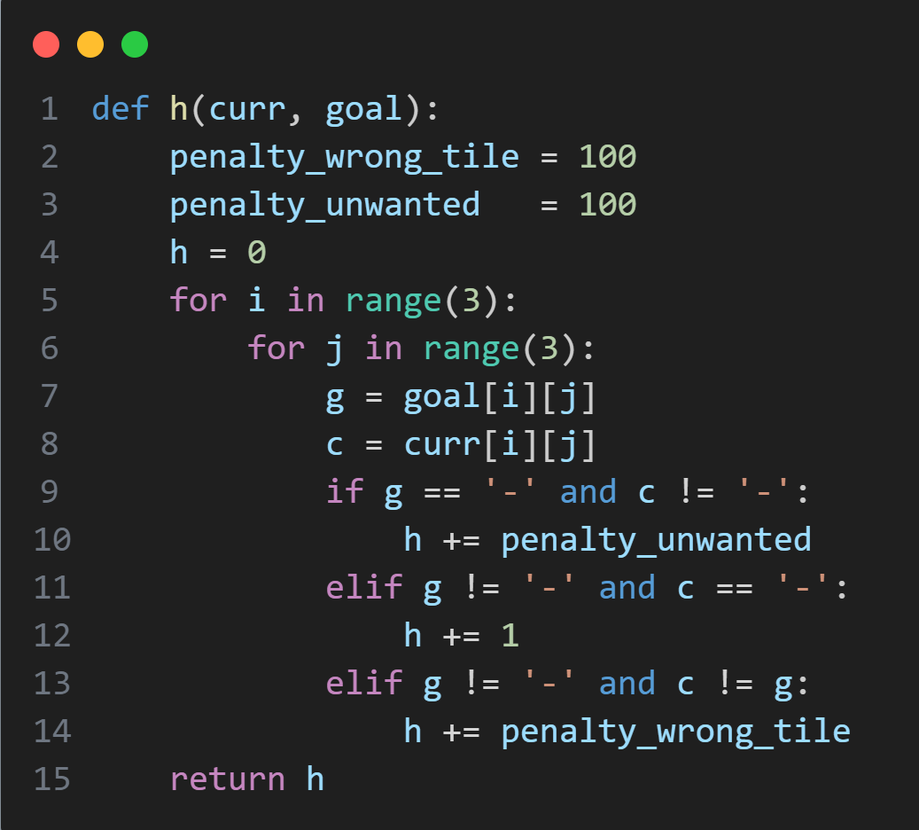
Code Snippets & Implementation Details
Next Possible Move Generation:
Heuristic Function (Key Logic):

Slide 6
Input and Output
Output/Solution Path
The output shows the sequence of states found by GBFS, the heuristic value of the previous state, the action taken, and the piece placed.
[([['x', '-', '-', '-'], ['-', '-', '-', '-'], ['-', '-', '-', '-'], ['-', '-', '-', '-']]),
([['x', '-', 'o', '-'], ['-', '-', '-', '-'], ['-', '-', '-', '-'], ['-', '-', '-', '-']]),
([['x', '-', 'o', '-'], ['x', '-', '-', '-'], ['-', '-', '-', '-'], ['-', '-', '-', '-']]),
([['x', 'o', 'o', '-'], ['x', '-', '-', '-'], ['-', '-', '-', '-'], ['-', '-', '-', '-']]),
([['x', 'o', 'o', 'x'], ['x', '-', '-', '-'], ['-', '-', '-', '-'], ['-', '-', '-', '-']])]
Start State | Goal State
[['x', '-', '-', '-'], ['-', '-', '-', '-'], ['-', '-', '-', '-'], ['-', '-', '-', '-']] | [['x', 'o', 'o', 'x'], ['x', '-', '-', '-'], ['-', '-', '-', '-'], ['-', '-', '-', '-']]
Note: The problem code uses but the heuristic function is defined for . The executed output is for the size initialized by n=4 and a valid start/goal based on file reading.

Slide 7
Analysis & Conclusion
Algorithm Suitability: Best-First Search (Greedy) is suitable for this problem as it prioritizes states that look 'closest' to the goal (fewer mismatches, more pieces placed correctly), aiming for a fast solution.
Path Cost: GBFS is not optimal (doesn't guarantee the shortest path/fewest moves), but the primary goal here is to find a path to the goal state efficiently, which facilitates.
Heuristic Effectiveness: The heuristic successfully guides the search by heavily penalizing irreversible mistakes (wrong piece, filling an unwanted cell) and lightly penalizing incomplete but correct moves.
State Representation: The list of lists is a clear and effective way to model the game board state.

Slide 8
Using Single Pair Shortest Path Algorithm: Problem Formulation & Transaction Format
Goal: Analyze a dataset of Indian dishes to find associations between attributes (like 'Place', 'IsVeg', 'TypeOfDish') and visualize the similarity between dishes as a Graph.
Input Dataset (datafood.csv):
Step 1: Convert to Transactional Format
The dataset is converted into a list of transactions, where each transaction is a list of attribute-value pairs.
Example Transaction (Dish 0): ['Dish=Butter Chicken', 'Place=North', 'IsVeg=No', 'TypeOfDish=Main']
Step 2: Create Binary Dataset
Each unique attribute-value pair is assigned a code (e.g., Place=North , IsVeg=Yes , etc.).
The data is converted into a binary matrix, where rows are transactions (dishes) and columns are all unique items (attribute-value pairs). A '1' indicates the item is present in the transaction.
Dish | Place | IsVeg | TypeOfDish
Butter Chicken | North | No | Main
Idli | South | Yes | Main
… | … | … | …

Slide 9
Graph Construction & Similarity Metric
Core Concept: Graph-based clustering/analysis using transaction similarity.
Graph Definition:
Nodes: Each transaction (i.e., each dish, indexed 0 to 10).
Edges: An edge exists between two nodes (transactions and ) if their similarity meets a predefined threshold.
Similarity Metric:
Metric: The number of shared attribute-value pairs between two dishes.
Calculated by performing a logical AND operation on the two binary vectors and summing the result.
where is the binary vector for transaction .
Edge Threshold:
An edge is added if the two dishes share at least 2 attribute-value pairs.

Slide 10
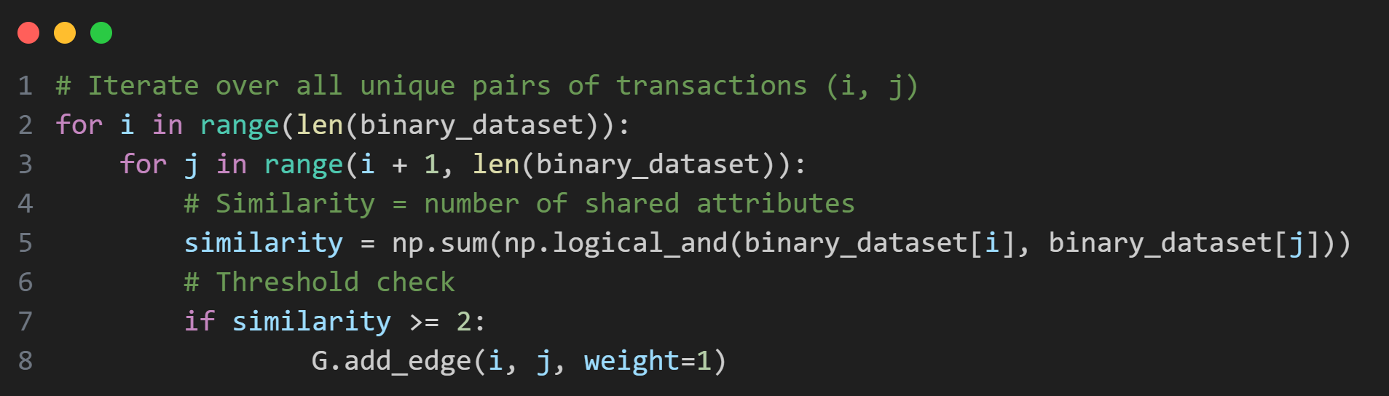
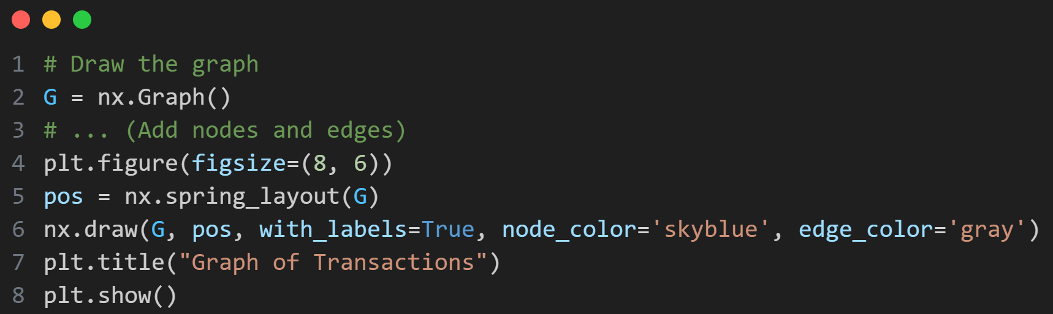
Code Snippets
Calculating Similarity & Adding Edges:
Graph Visualization (NetworkX):

Slide 11
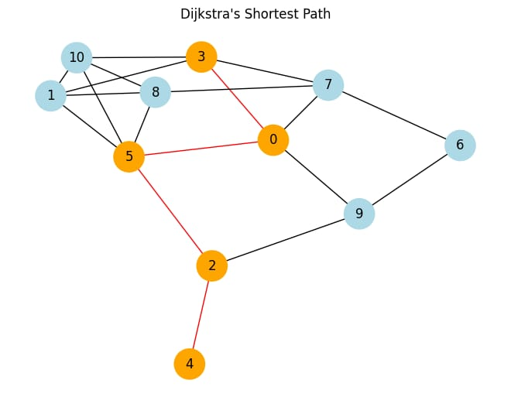
Graph Output & Shortest Path
Visualized Graph (Example):
Shortest Path Analysis (Dijkstra's Algorithm):
The code includes a function djikstra() to find the shortest path between two nodes (dishes) on the constructed graph, where edge weights are simply 1 (due to the ≥2 shared feature threshold).
Example Input: Start Node 4 (Papad), End Node 3 (Fish Curry)
Example Output:
Dijkstra's Shortest Path: [4, 2, 5, 0, 3]
Interpretation: The shortest sequence of related dishes to go from Dish 4 to Dish 3 is through dishes 2, 5, and 0.

Slide 12
Analysis & Conclusion
AI Technique: The transformation of tabular data into a similarity graph is a form of data clustering/relation extraction, a core data mining technique.
Graph Utility: The graph reveals non-obvious relationships between dishes based on shared features. For example, two dishes are similar if they share the same Place and TypeOfDish, even if they are different Dishes.
Shortest Path: Using Dijkstra’s algorithm allows for measuring the relational distance between any two dishes, providing a basis for recommendations or grouping.
Weighting: Currently, all edges have a weight of 1. Future work could use the actual similarity value (number of shared features) as the edge weight to represent a stronger relationship, which would provide a more nuanced shortest path result (finding the path that passes through the most highly related dishes).

Slide 13
Tower of Hanoi - Problem Formulation & State Space
Goal: Transfer disks from a Source Rod to a Destination Rod, using an Auxiliary Rod, following two rules:
Only one disk can be moved at a time.
A larger disk may never be placed on top of a smaller disk.
Core Concept: Search and Recursive Problem Solving.
State Space: Defined by the arrangement of disks across the three rods (A, B, C).
Rods: Defined by a stack.
Disks: Numbered (smallest) to (largest).
State Representation: A tuple/list of three stacks (tuples/lists), where each stack represents a rod, and the elements are the disks on that rod, from bottom to top.

Slide 14
Recursive Solution
The canonical Towers of Hanoi solution is inherently recursive, following a Divide and Conquer strategy.
hanoi(n, source, auxiliary, destination, pegs)
Base Case: If , move the single disk from source to destination.
This is the simplest, terminal action.
Recursive Step 1: Move disks from source to auxiliary, using destination as the auxiliary rod.
hanoi(n - 1, source, destination, auxiliary, pegs)
Recursive Step 2: Move the (largest) disk from source to destination.
This is the critical step, as the largest disk can only be moved when the destination rod is empty or has a larger disk (which, by this point, is guaranteed).
Recursive Step 3: Move the disks from auxiliary to destination, using source as the auxiliary rod.
hanoi(n - 1, auxiliary, source, destination, pegs)

Slide 15
BFS Solution
The second approach uses Breadth-First Search (BFS) to find the shortest sequence of moves, modeling the problem as a graph search.
BFS Implementation:
State Representation: A tuple of three tuples is used to ensure the state is hashable for the visited set.
Queue & Visited Set: A queue stores (state, path) tuples for exploration. The visited set stores the tuple representation of all explored states.
Neighbor Generation (Actions): At each step, the algorithm considers moving the top disk of any rod to any other rod, subject to the "no larger on smaller" rule.
The code tracks the permissible moves (e.g., Rule 1: Move disk 1 from A to B).
Can Place Check: The _can_place function enforces the rule based on the order (increasing/decreasing) of the destination rod's stack.
Termination: The search stops when the goal_state is reached, and the path records the sequence of states and the rule number used.

Slide 16
Output & Steps
Input/Example (3 Disks):
n: 3
Initial Rod/Order: A / decreasing ([3, 2, 1] on A)
Final Rod/Order: C / decreasing ([3, 2, 1] on C)
Output (Steps Table from BFS - Path to Goal):
| S.No. | Rod A | Rod B | Rod C | Rule no. |
| :---: | :---: | :---: | :---: | :---: |
| 1 | [3, 2, 1] | [] | [] | Initial state |
| 2 | [3, 2] | [] | [1] | 2 (Move disk 1 from A to C) |
| 3 | [3] | [2] | [1] | 7 (Move disk 2 from A to B) |
| 4 | [3] | [2, 1] | [] | 6 (Move disk 1 from C to B) |
| 5 | [] | [2, 1] | [3] | 14 (Move disk 3 from A to C) |
| 6 | [1] | [2] | [3] | 3 (Move disk 1 from B to A) |
| 7 | [1] | [] | [3, 2] | 10 (Move disk 2 from B to C) |
| 8 | [] | [] | [3, 2, 1] | 2 (Move disk 1 from A to C) |

Slide 17
Analysis & Conclusion
Recursive vs. BFS:
Recursive: Provides the canonical, minimum-move solution ( moves). It's a Depth-First-like approach tailored to this specific problem structure.
BFS: Guarantees finding a shortest path in the general state space graph (minimal number of state transitions). For Hanoi, this is the solution.
Constraint Handling: The complexity of the BFS approach lies in correctly modeling the problem constraints ("no larger on smaller") during neighbor generation via the _can_place check.
Generality: The BFS solution is more general as it can be adapted to variations where the disks must be stacked in an increasing (non-canonical) or decreasing (canonical) order on the destination rod.
Checks all possibilities: The BFS Solution tries for each and every possibility from one state whereas the recursive solution takes the best move.

Slide 18
Missionaries and Cannibals:
Farmer-Wolf-Goat-Cabbage Problem
Formulation & State Space
Goal: Transport a farmer (F), wolf (W), goat (G), and cabbage (C) across a river, given the constraint that:
The wolf will eat the goat if the farmer is absent.
The goat will eat the cabbage if the farmer is absent.
Core Concept: Uninformed Search / State Space Traversal.
State Representation: A 1D list of 4 binary elements: .
State - A 1D list of 4 elements [F, C, G, W] where each is 0 (left bank) or 1 (right bank).
F = farmer
W = wolf
G = goat
C = cabbage
So initial = (0,0,0,0) and goal = (1,1,1,1).
Failure States (if farmer is not with the pair):
Wolf and Goat on the same bank () AND Farmer is on the opposite bank ().
Goat and Cabbage on the same bank () AND Farmer is on the opposite bank ().

Slide 19
Uninformed Search Algorithms Implemented
The problem is solved using several Uninformed Search strategies, comparing their path, time, and memory usage.
Algorithm | Type | Strategy | Completeness & Optimality
BFS | Graph Search | Explores level by level. | Complete & Optimal (shortest path).
DFS | Graph Search | Explores to the deepest node first. | Complete (for finite spaces), Not Optimal.
DLS | Graph Search | DFS with a predefined depth limit (). | Incomplete (if is too small), Not Optimal.
IDS | Graph Search | Repeated DLS with increasing limits (). | Complete & Optimal (shortest path).
UCS | Graph Search | Explores based on lowest path cost (). | Complete & Optimal (lowest cost path).
ILS | Graph Search | Repeated DFS/A* with increasing cost limit (). | Complete & Optimal (lowest cost path).

Slide 20
Key Code & Output Metrics
Next Possible Moves (next_possible_move):
The farmer moves alone or takes one passenger (W, G, or C) if they are on the same bank. Crucially, a move is only added if the resulting state is not a failure state.
Cost Function (UCS/ILS - step_cost1):
h(n) is the number of different bits (elements) between the current state and the goal state. This makes UCS/ILS function like an A with a simple, admissible heuristic*, as it prefers states closer to the goal configuration.
def step_cost1(curr, next_state, goal):
# Cost = number of different bits between next_state and goal
sum=0
for i in range(len(goal)):
if next_state[i] != goal[i]:
sum=sum+1
return sum
Output Metrics Measured:
Path: The sequence of states from to .
Time: Execution time in seconds.
Peak Memory: Memory usage in bytes (for comparing memory efficiency).
Cost (UCS/ILS): The path cost based on the cost function.

Slide 21
Solution Path & Performance Summary
Shortest Path Found (Consistent across BFS/DFS/IDS/UCS/ILS):
[0, 0, 0, 0] (Initial State: All Left)
[1, 0, 1, 0] (Ferry G Right)
[0, 0, 1, 0] (Ferry F Left)
[1, 1, 1, 0] (Ferry W Right)
[0, 1, 0, 0] (Ferry G Left)
[1, 1, 0, 1] (Ferry C Right)
[0, 1, 0, 1] (Ferry F Left)
[1, 1, 1, 1] (Ferry G Right Goal State)
Performance Comparison (Averages from multiple runs): Above
AlgoID | Algorithm | Avg Time (ms) | Avg Memory (Bytes) | Path Cost (UCS/ILS)
0 | BFS | 0.204 | 1936 | 12
1 | DFS | 0.176 | 1888 | 12
4 | UCS | 0.128 | 1424 | 12
5 | ILS | 0.471 | 1392 | 12

Slide 22
Analysis & Conclusion
Optimal Solution: The problem has a shortest path length of 7 moves (8 states, including start). The UCS/ILS cost of 12 reflects the sum of the simple heuristic across the 7 moves (all 7 steps had except the first, which also had a cost of 1, resulting in a total path cost of ).
Performance:
BFS vs. DFS: DFS is slightly faster but uses comparable memory for this small state space.
UCS/ILS: UCS is the fastest and most memory-efficient of the general algorithms tested, leveraging the simple heuristic effectively. ILS, which is essentially an Iterative Deepening version of UCS/A*, is much slower due to repeated path explorations.
IDS vs. DLS: IDS successfully finds the shallowest solution (depth 7), while DLS requires setting the depth limit precisely to the solution depth. IDS is generally preferred as it is guaranteed to find the shallowest path.

Slide 23
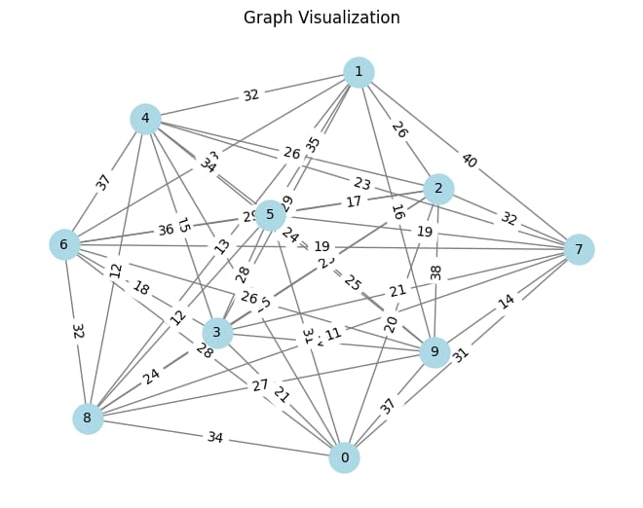
Traveling Salesperson Problem (TSP):
Problem Formulation & Input
Goal: Find the shortest possible route that visits every city (node) exactly once and returns to the origin city. This is an NP-hard problem.
Core Concept: Heuristic Optimization / Metaheuristics.
Input Format (from input.txt):
n e (Number of vertices and edges)
Lines of: u v cost (Edges and their weights)
Problem Graph: A graph with vertices (cities) and weighted edges representing the cost/distance between cities.

Slide 24
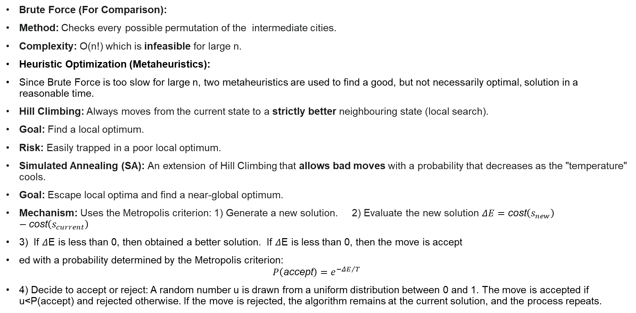
Brute Force Approach & Heuristic Optimization
Brute Force (For Comparison):
Method: Checks every possible permutation of the intermediate cities.
Complexity: O(n!) which is infeasible for large n.
Heuristic Optimization (Metaheuristics):
Since Brute Force is too slow for large n, two metaheuristics are used to find a good, but not necessarily optimal, solution in a reasonable time.
Hill Climbing: Always moves from the current state to a strictly better neighbouring state (local search).
Goal: Find a local optimum.
Risk: Easily trapped in a poor local optimum.
Simulated Annealing (SA): An extension of Hill Climbing that allows bad moves with a probability that decreases as the "temperature" cools.
Goal: Escape local optima and find a near-global optimum.
Mechanism: Uses the Metropolis criterion: 1) Generate a new solution. 2) Evaluate the new solution $ΔE=\text{cost}\left(s_{new}\right)−\text{cost}\left(s_{current}\right)$
3) If $Δ$E is less than 0, then obtained a better solution. If $Δ$E is less than 0, then the move is accept
ed with a probability determined by the Metropolis criterion:
$P\left(\text{accept}\right)=e^{−ΔE/T}$
4) Decide to accept or reject: A random number u is drawn from a uniform distribution between 0 and 1. The move is accepted if u<P(accept) and rejected otherwise. If the move is rejected, the algorithm remains at the current solution, and the process repeats.

Slide 25
Implementation Details (Neighbourhood & Cost)
Shared Components (Hill Climbing & SA):
State Representation: A permutation of the cities (e.g., [6, 3, 4, 0, 2, 5, 8, 1, 9, 7]).
Neighborhood Search: A neighbor is generated by a simple 2-swap operation: two random cities in the current route are swapped.
Cost Function (route_length): Calculates the total cost of a route (sum of edge weights, including the final return to the start). Returns float('inf') if an edge does not exist.
Simulated Annealing (SA) Logic:
Initial Temperature (): (High initial freedom to explore).
Cooling Rate (): (Controls how fast the system settles).
Acceptance Probability: A worse route is accepted if . This allows for exploration of the state space, a key difference from Hill Climbing.

Slide 26
Output & Comparison
Input: A graph with 10 cities () and multiple weighted edges.
Output:
Algorithm | Max Iterations | Best Route (Example) | Best Cost
Hill Climbing | 100,000 | [6, 3, 4, 0, 2, 5, 8, 1, 9, 7, 6] | 160
Simulated Annealing | 100,000 | [5, 2, 1, 9, 7, 6, 3, 0, 4, 8, 5] | 171
Brute Force | N/A | (Infeasible for ) | -

Slide 27
Analysis & Conclusion
Hill Climbing (HC): Found a better route (Cost 160) than SA in this specific run. This suggests that the initial random start was already close to a good local optimum, or the specific problem landscape allowed HC to succeed.
Simulated Annealing (SA): Found a slightly worse route (Cost 171). SA's strength is typically for more complex landscapes where HC would certainly get stuck. The parameters heavily influence its performance.
Heuristic Necessity: For the case, Brute Force would involve checking routes. While feasible for this size, the metaheuristics demonstrate the necessary approach for the general TSP where is much larger, effectively pruning the search space.
Final Output: The final TSP tour is a crucial output, but the cost value is the key metric for comparing the efficiency of the heuristic optimization techniques.

Slide 28
The 8-Puzzle Problem (Sliding Tile Puzzle)
Problem Definition
Goal: Transform the Start State into the Goal State by sliding tiles into the blank space.
State Space: An matrix (typically ) containing tiles 1 to and the blank tile (represented by ).
Core Concept: Iterative Deepening Search (IDS), a complete and optimal uninformed search.
Input/output States (Example)
Start State | Goal State (Solved)
[[1, 4, 2], [3, 0, 5], [6, 7, 8]] | [[1, 2, 3], [4, 5, 6], [7, 8, 0]]

Slide 29
Key AI Algorithm: Iterative Deepening Search (IDS)
IDS combines the optimality of BFS with the memory efficiency of DFS by using Depth-Limited Search (DLS) as its core engine.
IDS Strategy
Iterative Deepening: Calls DLS repeatedly, increasing the depth limit until the goal is found.
Path Optimality: Guaranteed to find the shallowest (shortest) solution path.
Memory Efficiency: The space complexity is low, , where is the depth of the solution, as it only stores the current path in memory.
Completeness: Guaranteed to find a solution if one exists, unlike a fixed DLS.

Slide 30
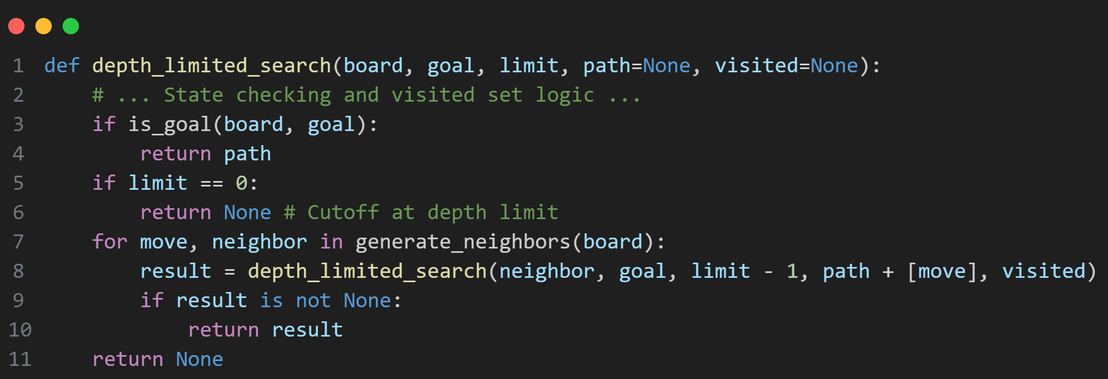
DLS Workhorse and Move Generation
Implementation: DLS and Neighbors
Depth-Limited Search (depth_limited_search)
DLS is the recursive function that executes the search at a specific depth limit, ensuring the overall IDS search remains bounded and complete.
Neighbor Generation
The generate_neighbors function finds the blank tile (0) and checks the four possible moves (Up, Down, Left, Right) within the board boundaries.

Slide 31
Output: Solution Path and Board Transitions
The final output is the minimal sequence of moves (U, D, L, R) that transitions the initial board to the goal state.
Example Board Transition (Move D)
Initial State | After move R | After move D
1 4 2 / 3 0 5 / 6 7 8 | 1 4 2 / 3 5 0 / 6 7 8 | 1 4 2 / 3 5 8 / 6 7 0
Output Format
The write_output function displays the board state and the move (U, D, L, or R) taken to reach that state, providing a clear trace of the solution path.
Initial state:
1 4 2
3 0 5
6 7 8
After move R:
1 4 2
3 5 0
6 7 8

Slide 32
Analysis and Conclusion
Conclusion: The 8-Puzzle has a wide, shallow search space where the optimal solution depth () is relatively small (max 31 moves for ).
IDS is optimal because it finds the shortest path while avoiding the massive memory overhead associated with storing all nodes at each level, which is required by BFS.
Analysis: Why IDS for the 8-Puzzle?
Metric | BFS (Breadth-First) | IDS (Iterative Deepening)
Path Optimality | Guaranteed (Shortest path length) | Guaranteed (Shortest path length)
Time Complexity | O(b^m) | (Competitive with BFS)
Memory/Space | (Exponential Memory) | (Linear Memory)

Slide 33
Thank
You

